Slide 1
DATA SCIENCE
Group Project

Slide 2
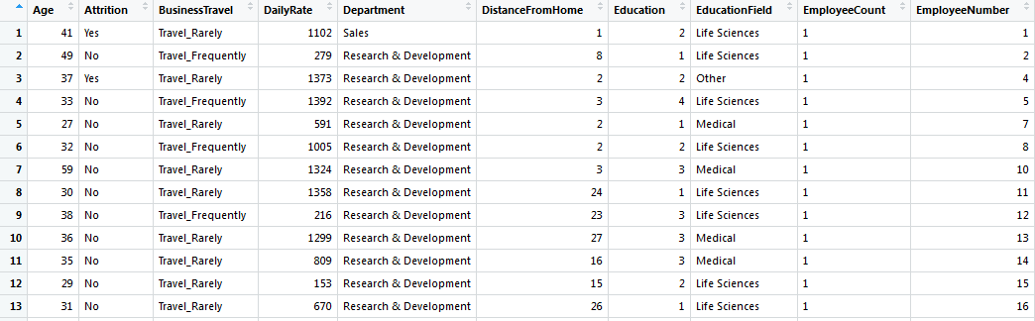
Dataset Description
The dataset for IBM HR Analytics which contains different attributes of an employee. Employee Number is the primary key.
Structure : 1470 observations, 35 variables.

Slide 3
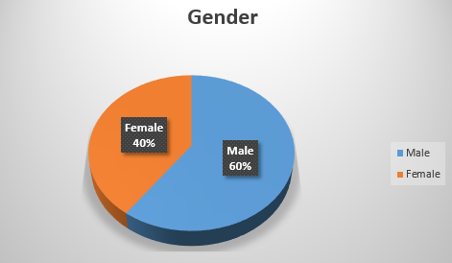
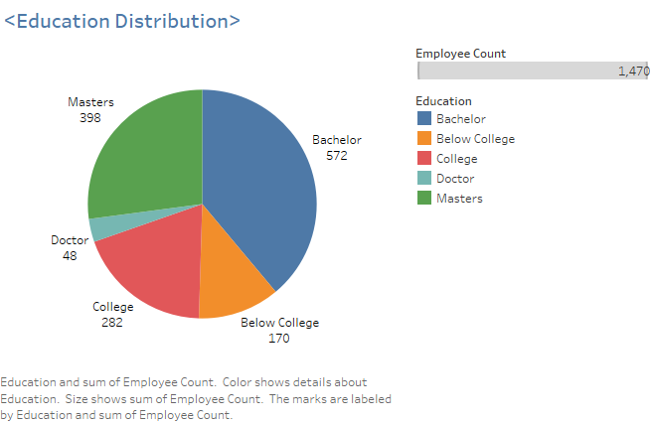
Education
The data involves 60% males where as there were maximum Bachelors
and Masters under study.

Slide 4
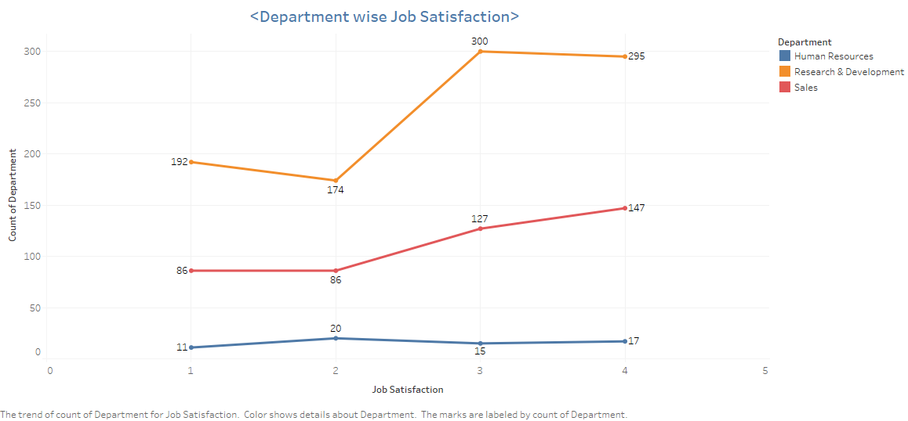
The Bar chart showing Attrition pretty less for all the satisfaction levels.
From the line chart we can see the Research & Development department has the highest
Satisfaction level where as Human Resources being Neutral.

Slide 5
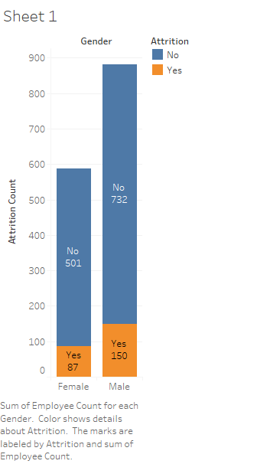
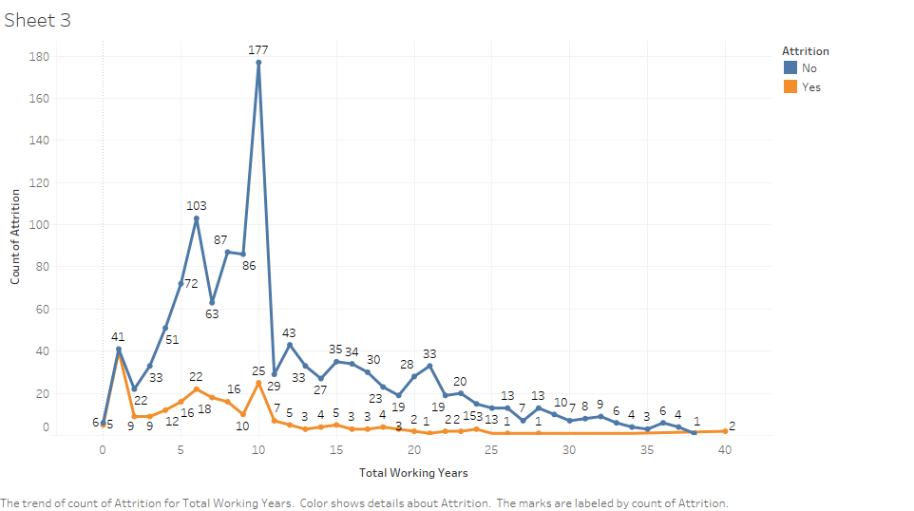
Gender V/S Attrition
Work Exp V/S Attrition
From the above plots we can say that as Experience increases Attrition becomes steady.
Where from the bar we can say that gender did not affected in attrition rate.

Slide 6
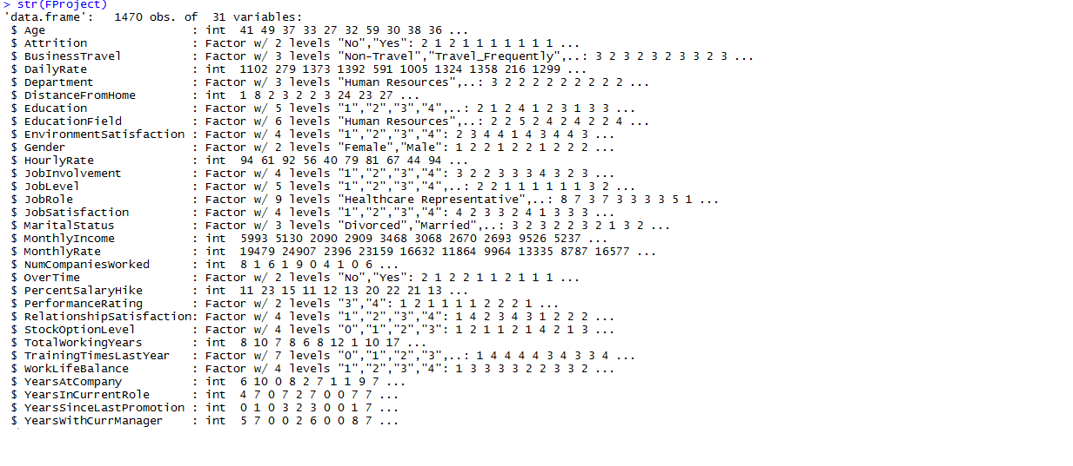
Structure of the Data:
The dataset consists of
Categorical and Numerical variables.
Attrition is the target Variable.

Slide 7


Feature Selection:
To remove variables with zero or less impact based on low entropy which means
low uncertainty and zero or low variance means no impact of variable on dependent variable.
Also: EmployNumber is being Removed since Unique Values variable.

Slide 8
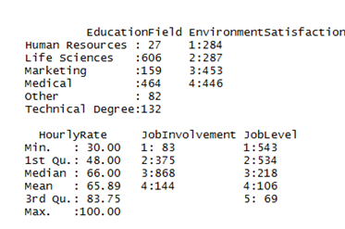
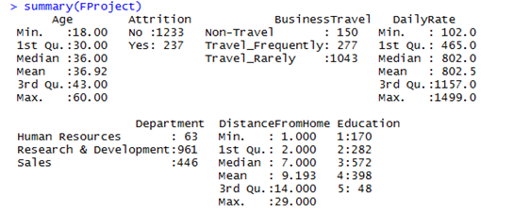
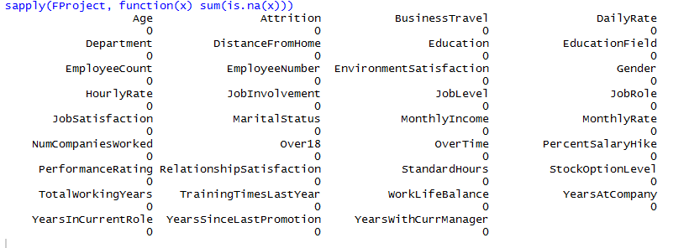
Exploratory Data Analysis
Summary:
Missing Values:
No missing values
in the data.

Slide 9
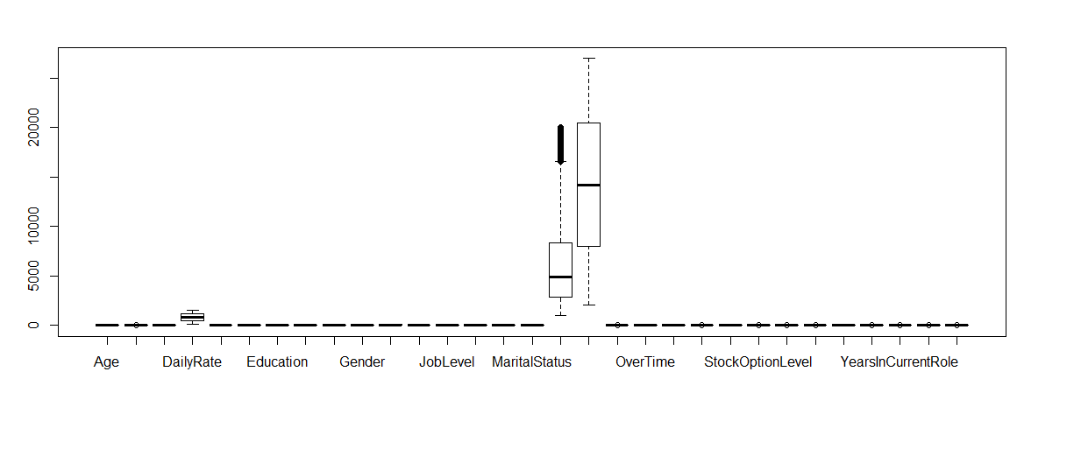
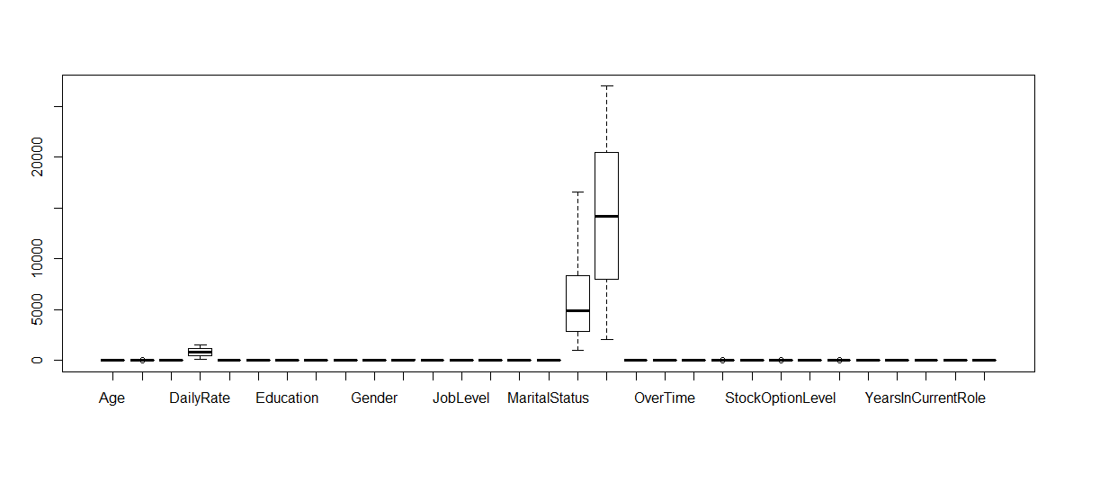
OUTLIERS
Without treated Boxplot
Treated Boxplot

Slide 10
OBJECTIVE: To study the effect of different factors on Attrition
Method Used:
BINARY LOGISTIC REGRESSION
Logistic regression is a regression model where the dependent variable is Categorical.
In this case we have only two values Attrition within Employees whether Yes / No.

Slide 11

The Binary logistic regression model is given by
Π(X) =
Where,
Π(X): Conditional probability that the outcome is present,
i.e. Pr(Y=1|X)
We use the transformation called logit, which forces the prediction equation to predict values between 0 and 1.
Logit transformation of above model:
g(x) =β0+Σβ1iX1i+Σβ2iX2i+......+ΣβpiXpi
Where,
g(x): Logit transformation of the probability of the event
β0: Intercept of the regression variables.
βi: Slope of ith regression variables.

Slide 12
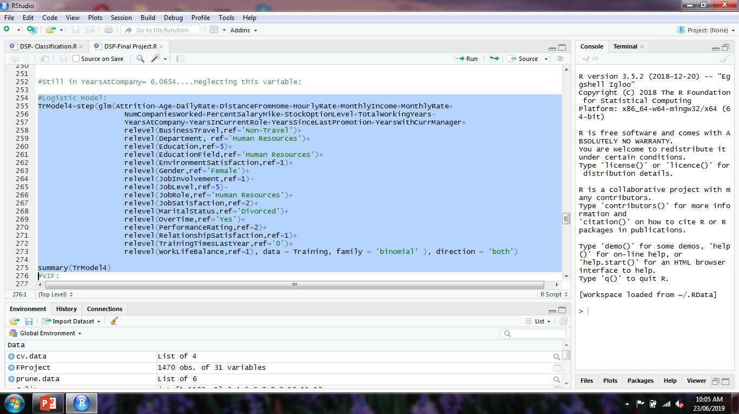
Dependent Variable :
Y= 1 (Yes)
Y= 0 (No)
Logistic Model:
Independent Variables:
f₁: Gender
f₂: Age
f₃: Education
f₄: Environment Statisfaction
f₅: JobInvolvement
f₆: JobSatisfaction
f₇: PerformanceRating
And 23 more…

Slide 13
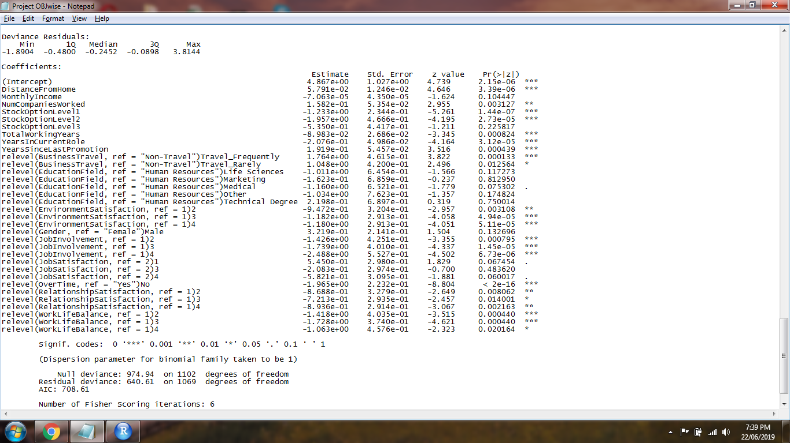
SUMMARY OF STEPWISE REGRESSION
Significant Variables:
DistanceFromHome
NumCompaniesWorked
StockOptionLevel
TotalWorkingyears
YearsInCurrentRole
YearsSinceLastPromotion
BusinessTravel
EducationField
EnvironmentalSatisfaction
Gender
JobInvolvement
jobSatisfaction
OverTime
RelationshipSatisfaction
Worklifebalance

Slide 14
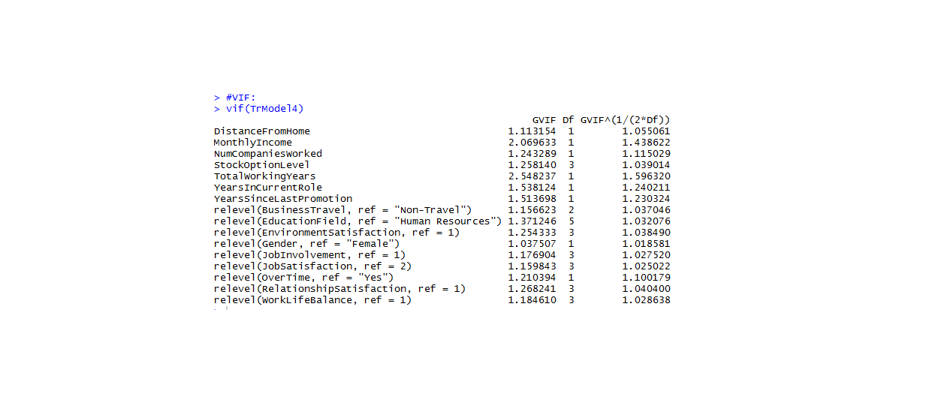
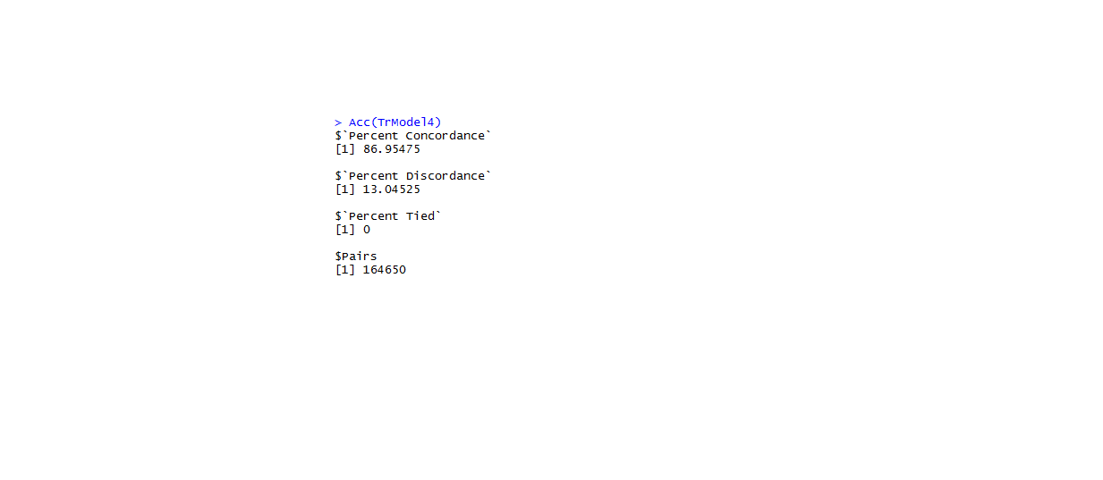
VARIANCE INFULATION FACTOR(VIF):VIF stands for Variance Inflation Factor. During regression analysis, VIF assesses whether factors are correlated to each other (multicollinearity), which could affect p-values and the model isn't going to be as reliable.
All GVIFs less than 5
Concordance and Discordance for Training Model
Criteria:
High Concordance, Low Discordance and
low Tied Pair, Better the model.

Slide 15
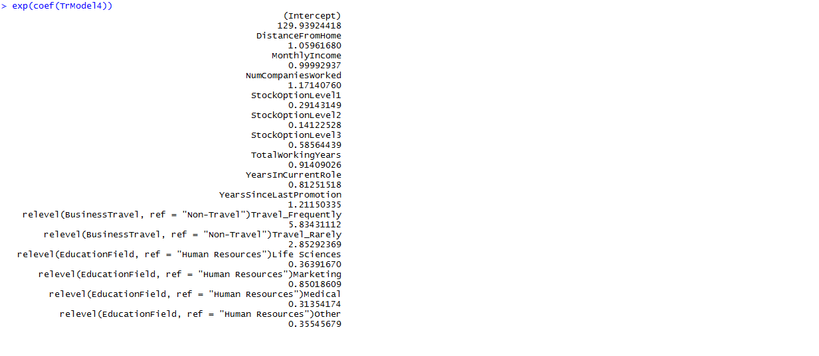
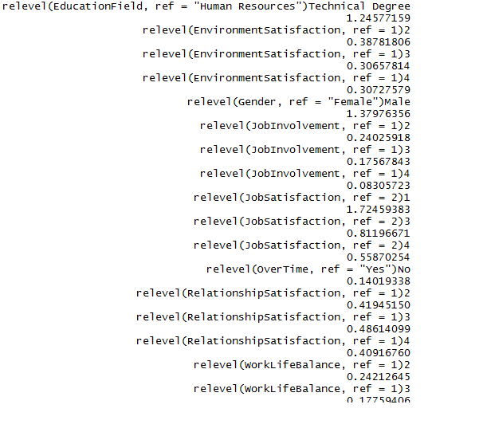
ODDS RATIO: The odds ratio measures the strength of association between a predictor and the response variable of interest.
Interpretation:
For Female V/S Male: The odds of females Attrition are 1.3797 times larger than the odds
of Males Attrition.

Slide 16
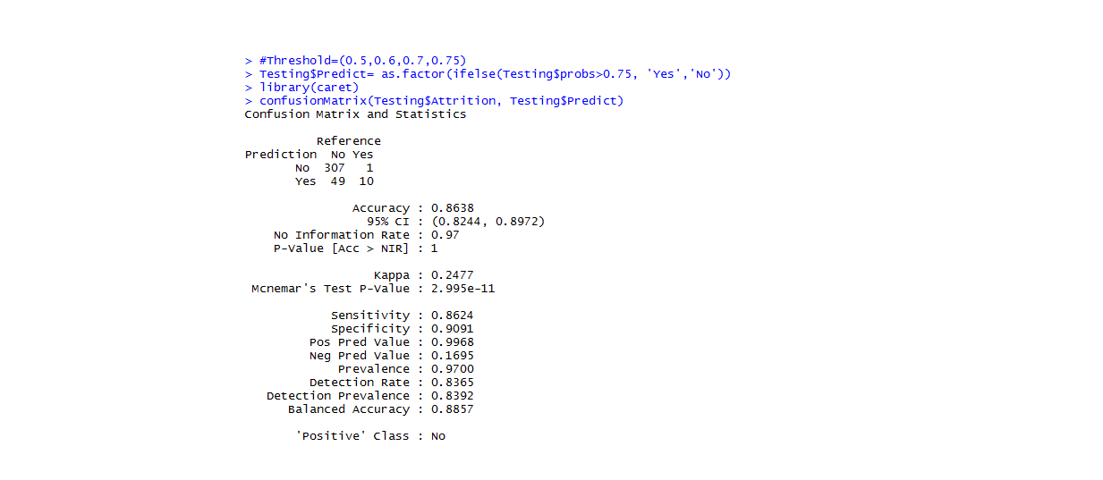
ACCURACY OF MODEL
CONFUSION MATRIX
Sensitivity: 0.8624
Specificity: 0.9091
Accuracy : 0.8638
Kappa : 0.2477

Slide 17
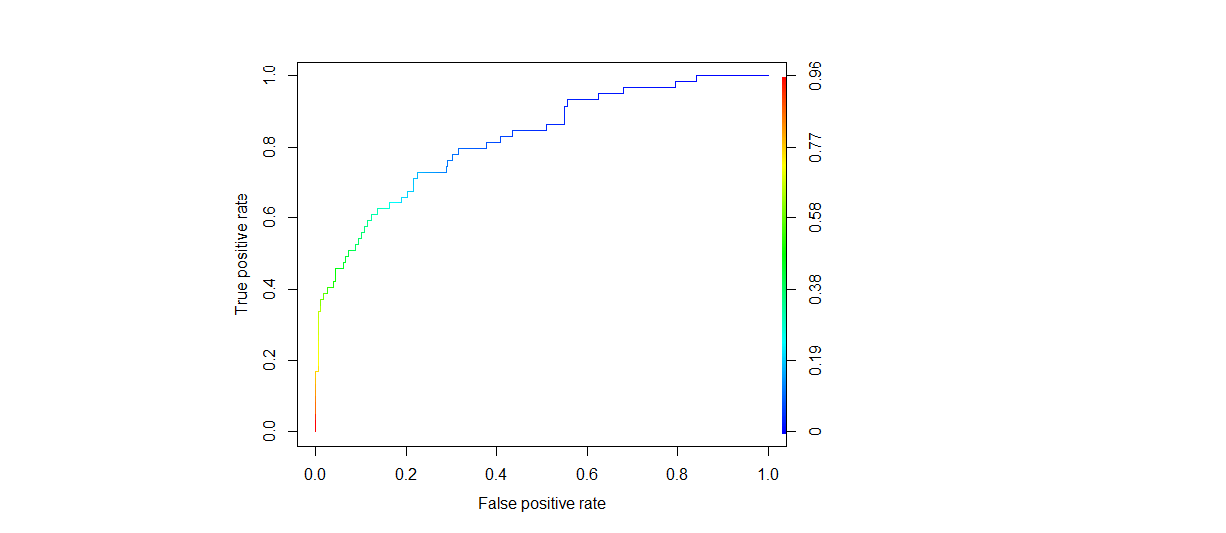
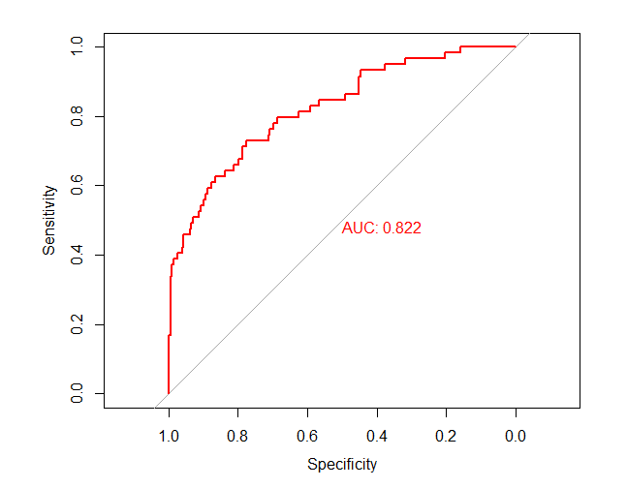
ROC and AUC of MODEL:

Slide 18
# OBJECTIVE:
Is distance from home a case for attrition?
DistanceFromHome Estimate= 4.149e-02
which means a unit increase in Distance from home increases
chance of Attrition by 0.0415 times...

Slide 19
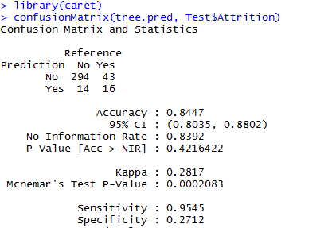
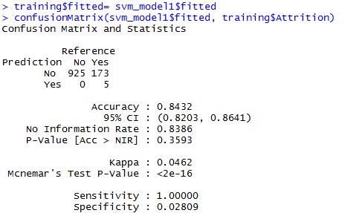
OBJECTIVE:
Build classification models to predict which employee is likely to churn?
Decision Tree:
SVM:
Since SVM model looks overfitted will proceed with Decision Tree.

Slide 20
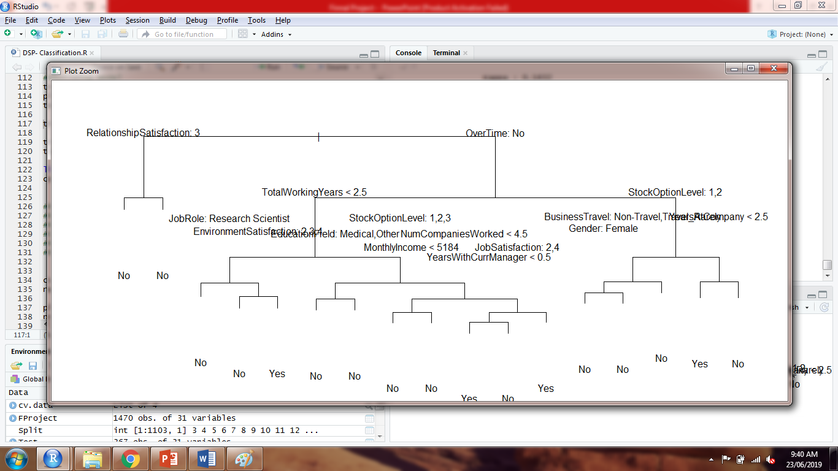
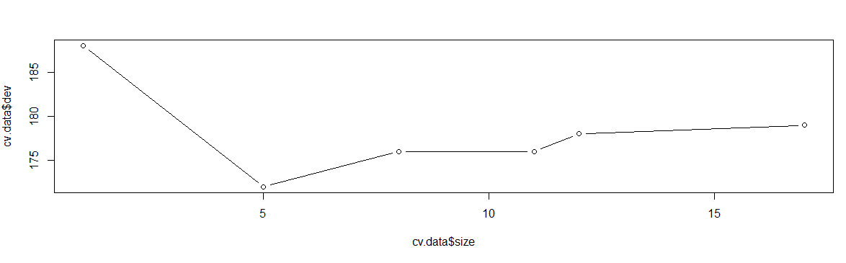
Tree: Based on OverTime
Based on the prune plot
12 trees can be extracted.

Slide 21
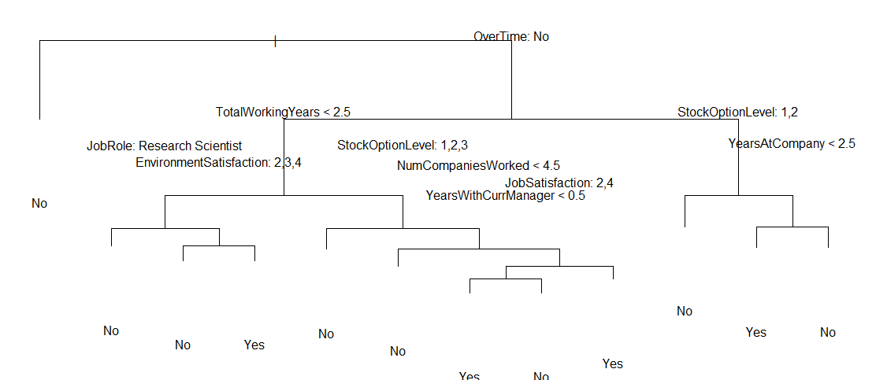
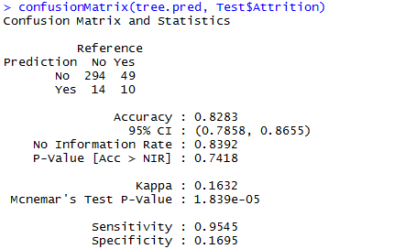
Final Decision Tree:
Accuracy:
Interpretation: OverTIme=Yes-TotlWOrkingYears>2.5-
JobRole:Research Scientist, chance is NO Attrition.

Slide 22
THANK YOU
-Presented By:
Rahul Singh
Tejas Nalawade
Laxminarayan Vishwakarma

